Slide 1
Services Science & Service Operational Management
CSBS VIII Sem

Slide 2
Introduction
September 2022
India Became the World’s Fifth-largest Economy
USA
China
Japan
Germany
INDIA
Britain

Slide 3
Introduction
The World's GDP is $ 103.86 trillion as on 2022
Rank | Country | 2020 | 2021 | 2022 (Billions) | 2023 | 2024 | 2025 | 2026
1 | United States | 20,893.75 | 22,997.50 | 25,346.81 | 26,695.15 | 27,745.53 | 28,790.40 | 29,855.87
2 | China | 14,862.56 | 17,458.04 | 19,911.59 | 21,865.48 | 23,617.43 | 25,353.05 | 27,171.94
3 | Japan | 5,040.11 | 4,937.42 | 4,912.15 | 5,291.35 | 5,527.69 | 5,820.00 | 6,063.32
4 | Germany | 3,843.34 | 4,225.92 | 4,256.54 | 4,564.78 | 4,786.67 | 4,985.45 | 5,177.01
5 | India | 2,667.69 | 3,177.92 | 3,534.74 | 3,893.67 | 4,270.77 | 4,681.95 | 5,100.70
6 | United Kingdom | 2,758.87 | 3,187.63 | 3,376.00 | 3,686.94 | 3,914.82 | 4,131.68 | 4,345.97
7 | France | 2,621.96 | 2,935.49 | 2,936.70 | 3,086.23 | 3,227.51 | 3,366.29 | 3,495.89
GDP: The total value of all the goods and services produced in a country in one year

Slide 4
Introduction
The World's GDP is $ 103.86 trillion as on 2022
The World's GDP is $ 103,860.00 billion as on 2022
India’s 2022 GDP is $3535 billion
India’s 2022 GDP is $3.535 trillion
India’s GDP is 248 lakh crores

Slide 5
Introduction
India’s GDP (2022) is 248 lakh crores
Contribution to GDP in %
Agriculture | Industry | Services
16 | 24 | 60

Slide 6
Introduction
India’s GDP (2022) is 248 lakh crores
India's GDP | 248 | lakh crore
Contribution to GDP in %
Agriculture | Industry | Services
16% | 24% | 60%
39.68 | 59.52 | 148.8

Slide 7
Introduction
USA’s GDP (2022) is 2071 lakh crores
India's GDP | 2071 | lakh crore
Contribution to GDP in %
Agriculture | Industry | Services
1% | 19% | 80%
20.71 | 393 | 1657

Slide 8
Introduction
India’s services sector covers a wide variety of activities such as
trade, hotel and restaurants, transport, storage and communication, financing, insurance, real estate, business services, community, social and personal services, and services associated with Health Care, Technology, Institution (Health Care), Tourism. ……………………….. ……………………………………………………………………..

Slide 9
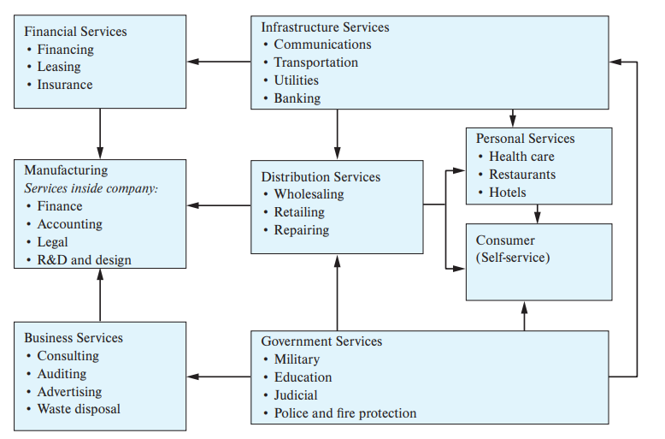
Introduction

Slide 10
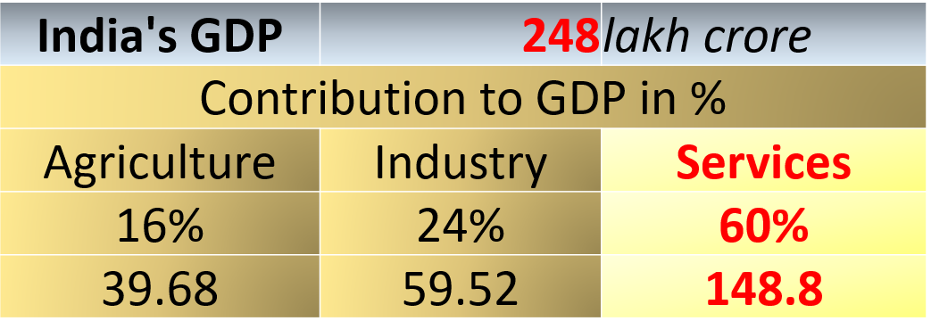
Introduction
Types of Services | % | Value in Lakh Crores
Financial Services | 7 | 10.43
Manufacturing Services | 14 | 20.86
Business Services | 27 | 40.23
Infrastructure Services | 12 | 17.88
Distribution Services | 14 | 20.86
Government Services | 20 | 29.8
Personal Services | 6 | 8.94

Slide 11
Introduction
Types of Services | % | Value in Lakh Crores
Financial Services | 7 | 10.43
Manufacturing Services | 14 | 20.86
Business Services | 27 | 40.23
Infrastructure Services | 12 | 17.88
Distribution Services | 14 | 20.86
Government Services | 20 | 29.8
Personal Services | 6 | 8.94
IT Services 35% 14

Slide 12
Introduction
IT Services 35% 14
My Company:
0.001% Market 100 Crore company

Slide 13
Introduction: Role of services to IE
Employment (Job Creation):
Out of 100 Jobs in the market, how many are Jobs (direct or indirect) are for service industry?
Example: No: of employs of TCS, IRCTC, Emirates Fly. …………..

Slide 14
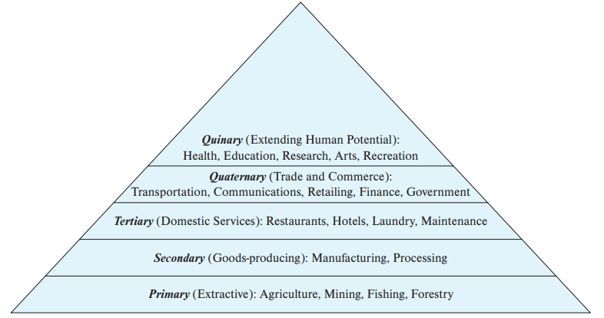
Introduction
Stages of Economic Activity
High paying JOBS
Hierarchy of economic activity

Slide 15
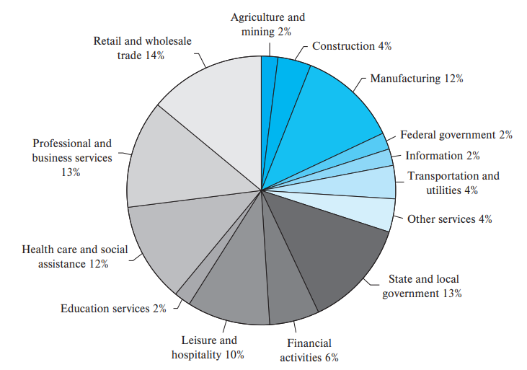
Introduction
Distribution of U.S. Employment by Industry, 2014.

Slide 16
Introduction
Distribution of Indian / (country of your choice) Employment by Industry, 2022.
Assignment:
One short paragraph on Service Job market and distribution of Jobs (Employment) in Indian or any country of your choice.
Do not just write a “Premise”, there should be premise indicator (conclusions or explanation i.e. supporting your premise with reasons / warrant)

Slide 17
Introduction
All economies are service economies.
Service Industry is the highest contributor to global and regional economy because of growing demand for better consumer experience.
Service Industry is the highest contributor to global and regional economy because it has seen an increased growth of 3.17% compared to last year.

Slide 18
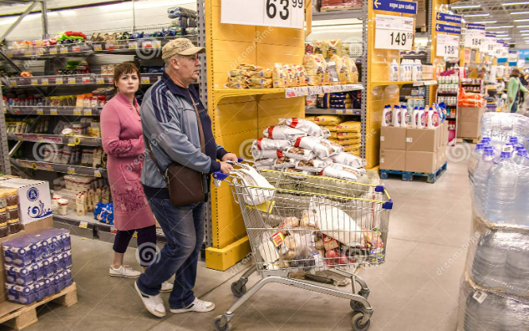
Introduction Nature of Services
Differences between services and operations
Retailer is selling GOODS / PRODUCTS
Service:
Free home delivery of purchased goods within an hour
From Consumer’s perspective
(B2C)

Slide 19
Introduction Nature of Services
Differences between services and operations
Retailer using IT software / Internet for quick transactions
Service:
Continuous support from software team & ISP provider
From Retailers perspective
(B2B)

Slide 20
Introduction Nature of Services
Differences between services and operations
Retailer purchasing shelf’s for product display
Service:
Immediate Repair / replacement from Shelf seller in case of malfunctioning
From Retailers perspective

Slide 21
Introduction

Slide 22
Characteristics of Service Operation
Supply AND Demand
Business function (or run) according to supply and demand
Commodity prices / Service prices are dependent upon Supply and Demand
Demand ----->
Price ------>

Slide 23
Characteristics of Service Operation
Case let:
(April ~ June 2020)
Product Services
Sanitizer SPAs, Saloons, Beauty Parlours
Online Meetings (Tools) Software Services

Slide 24
Characteristics of Service Operation
Sanitizer
Months | Sales (million units) | Consumption (lakh Litres) | Supply (Litres) | Demand
Oct-19 | 10 | 10 | 9.95 | 1.005
Dec-19 | 10.02 | 10.02 | 10 | 1.002
Jan-20 | 10.01 | 10.01 | 10.01 | 1.000
Feb-20 | 10 | 10 | 10.01 | 0.999
Mar-20 | 10 | 10 | 10.01 | 0.999
Apr-20 | 10 | 11 | 10.01 | 1.10
May-20 | 10 | 13 | 10.01 | 1.30
Jun-20 | 10.02 | 18 | 10.02 | 1.80
Jul-20 | 13 | 20 | 13 | 1.54
Aug-20 | 20 | 21 | 20 | 1.05
Discuss product pricing subject to demand and supply (month wise)?

Slide 25
Characteristics of Service Operation
Exercise:
Illustrate the same for “Online Meeting Tools”
(Sales of MST / Zoom / Google Meet etc. Subscriptions / Licences ……. Pre Covid, During Covid and Post Covid)
What impact did it create for Software Services during those period?

Slide 26
Characteristics of Service Operation
SPAs, Saloons, Beauty Parlours
Case let of the above mentioned services in terms of Demand, Supply, Resources and most important “Customer Participation”
Banks
How much did “Customer Participation” impact Banking Services (as compared to offline banking)

Slide 27
Characteristics of Service Operation
1. Customer Participation (page 13 & 14)
2. Simultaneity (page 14): The fact that services are created and consumed simultaneously and, thus, cannot be stored is a critical feature in the management of services.
Example: Qatar World Cup 2022
3. Perishability (page 14): A service is a perishable commodity.
Example: Hotel occupancy, footfall during weekends
Ticket pricing for IPL

Slide 28
Characteristics of Service Operation
4. Intangibility (page 15): Services are ideas and concepts; products are things. Therefore, it follows that service innovations are not patentable.
Example: Franchising (Eatery, Software Services)
5. Heterogeneity (page 15): The combination of the intangible nature of services and the customer as a participant in the service delivery system results in variation of service from customer to customer.
Example: Automobile companies (proactively) recalling defective (minor) products (cars) and getting it repaired or serviced free of cost

Slide 29
Characteristics of Service Operation
6. Non Transferrable Ownership (page 16): From a marketing perspective, services, unlike goods, do not involve transfer of ownership. If customers do not receive ownership when they purchase a service, then what are they buying?
Example: I have purchased a device for faster network connectivity, but experiencing same issues of frequents dropping of calls / connectivity

Slide 30
Characteristics of Service Operation

Slide 31
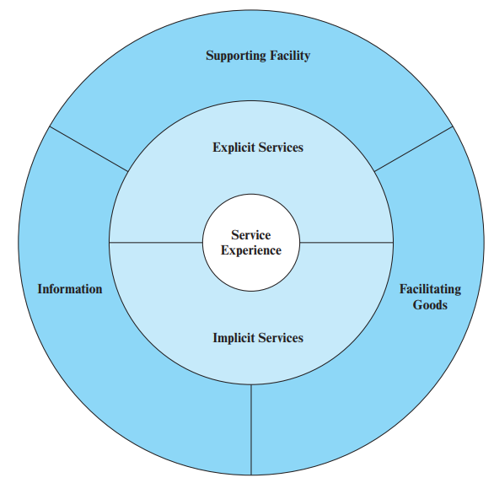
Service Package
The service package is defined as a bundle of goods and services with information that is provided in some environment.

Slide 32
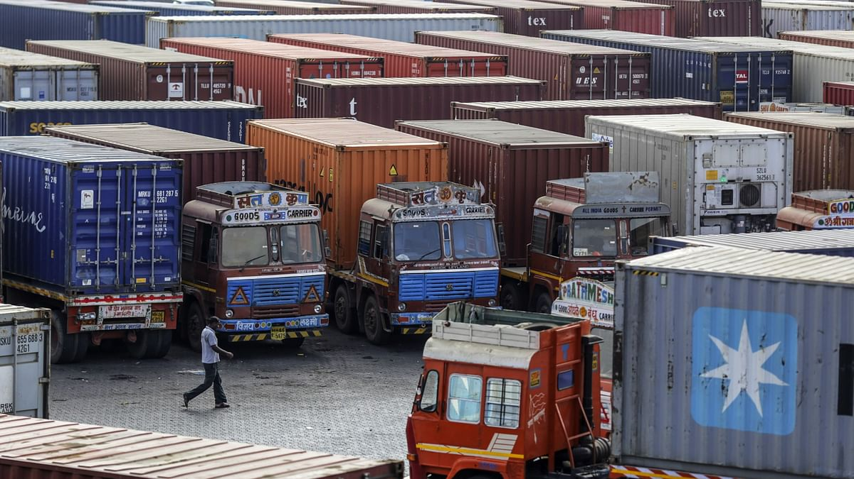
Service Package
Example : Logistic Services (SCM)
Supporting Facility : Physical resources i.e. Fleet of vehicles, Parking Area

Slide 33
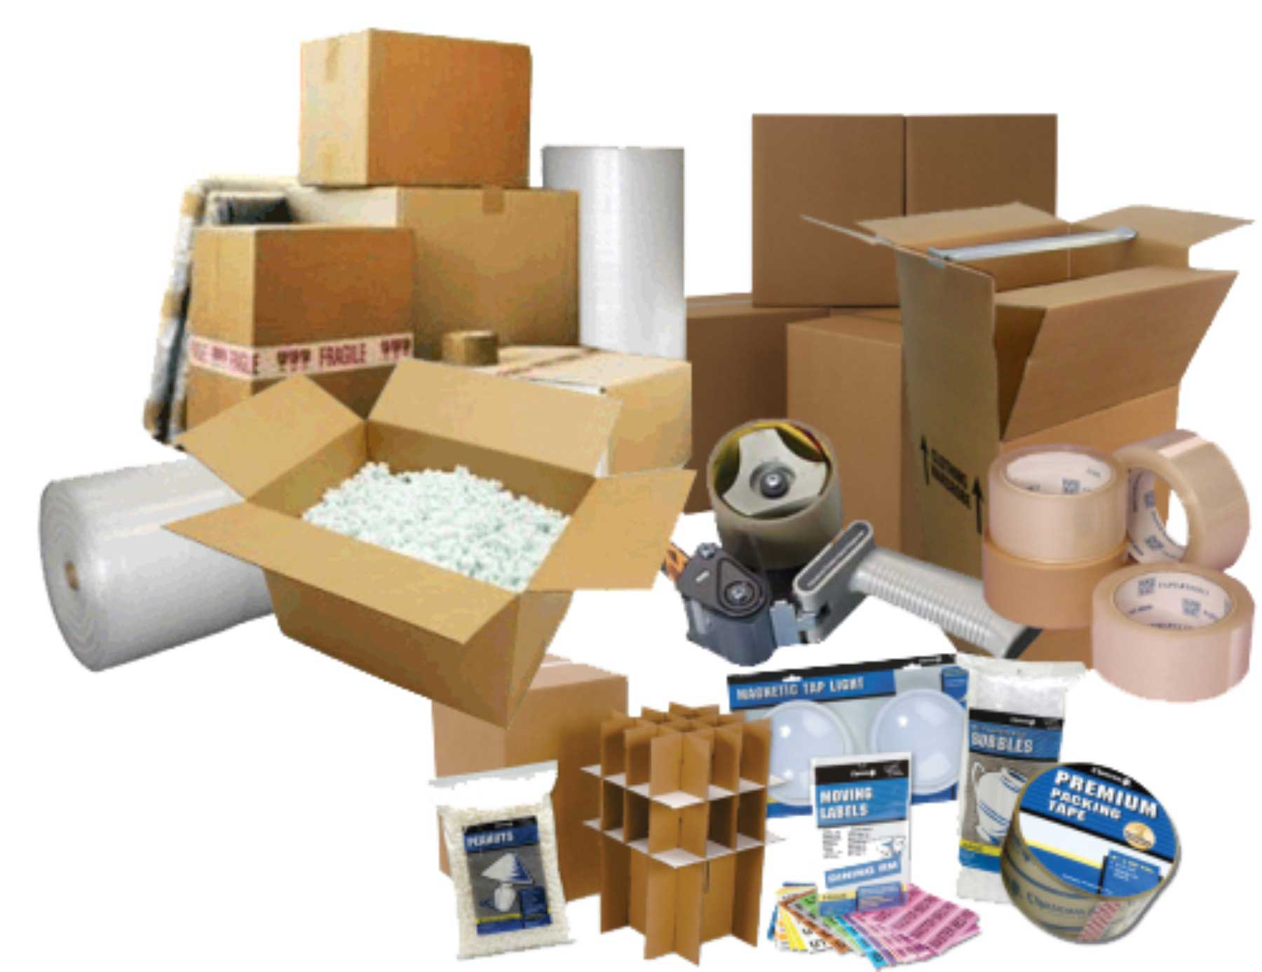
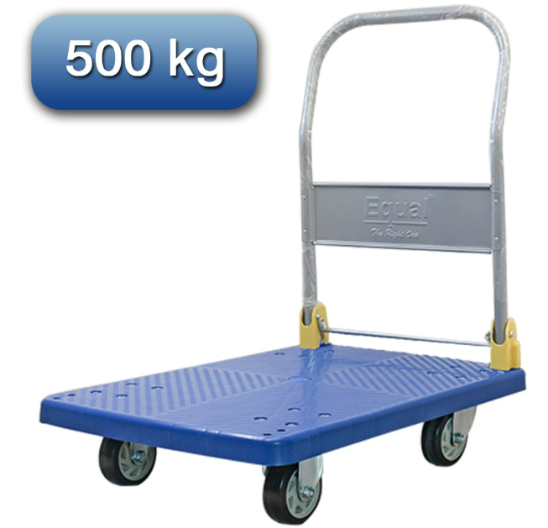
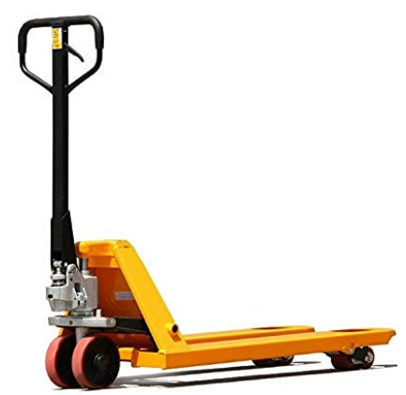
Service Package
Example : Logistic Services (SCM)
Facilitating Goods: Material purchased or consumed by buyers i.e. Packing boxes, Trolleys, hand pallet trucks

Slide 34
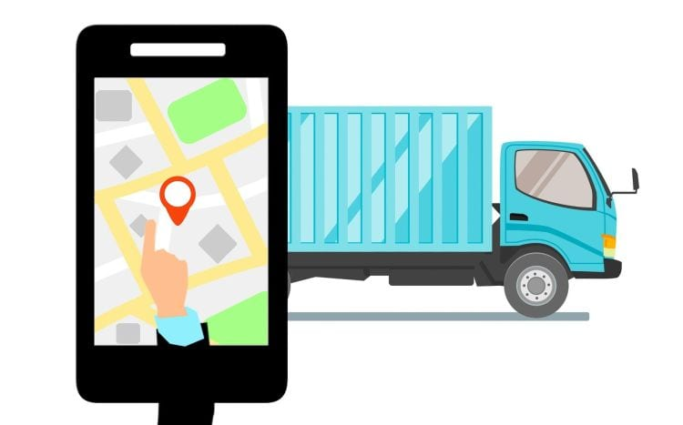
Service Package
Example : Logistic Services (SCM)
Information: Data that is available from the customer or provider to enable efficient and customized service i.e. Loading / Unloading time, Real Time Monitoring or tracking of transport vehicles

Slide 35

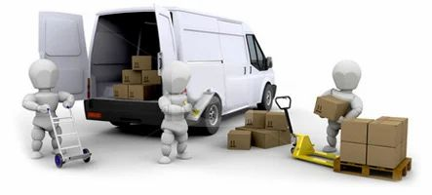

Service Package
Example : Logistic Services (SCM)
Explicit Services: Benefits that are readily observable i.e. Trained professionals taking care from packing – Loading to vehicle – Movement of Goods – Timely delivery

Slide 36
Service Package
Example : Logistic Services (SCM)
Implicit Services: Psychological benefits that the customer may sense or experience i.e. Value to the customers

Slide 37
Service Package
A service package is a bundle of explicit and implicit benefits performed with a supporting facility and using facilitated goods.
Brainstorming Vs Data Analysis
(What do customers buy, Should I do brainstorming or analyze historical data)

Slide 38
Service Encounter
Encounter

Slide 39



Service Encounter

Slide 40
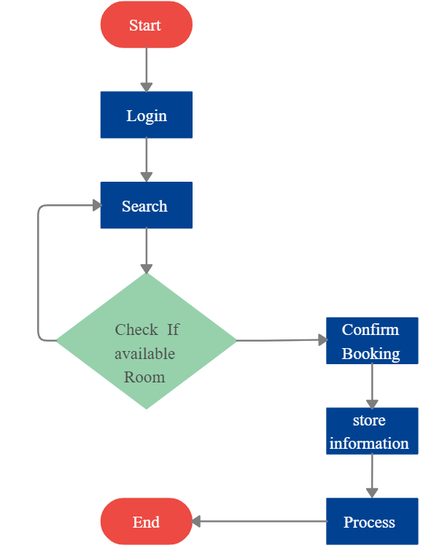

Service Encounter

Slide 41
Service Encounter
Customer Experience (Explicit / Implicit)
Hotel Reservation
Hotel Stay
Check out
1st Encounter
2nd Encounter
3rd Encounter

Slide 42
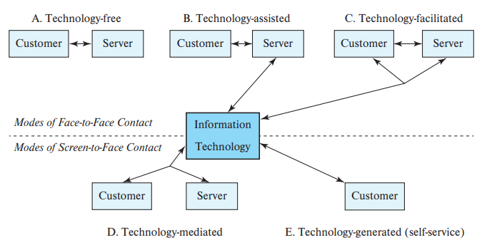
Service Encounter
Role of Technology in Service Encounter

Slide 43
Service Encounter
Importance of Encounters
During Encounters, The interaction, which defines the quality of the service in the mind of the customer, is called a “moment of truth.” Often a brief encounter is a moment in time when the customer is evaluating the service and forming an opinion of its quality.

Slide 44
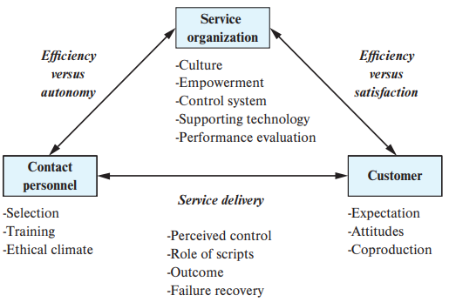
Service Encounter
The Service Encounter Triad (page 98)

Slide 45
Service-Dominant Logic
Focusing on the customer and serving his or her needs is the basis for a service-dominant logic that is an alternative to the traditional goods-centered paradigm.

Slide 46
Service-Dominant Logic
https://www.youtube.com/watch?v=KAKNEiCPiYI
Top 5 Best Split AC [ Air Conditioners ] in 2022
https://www.youtube.com/watch?v=rXMbQxdq_ps
Mandatory Facilities for hotel guest in a 5 star hotel? Mandatory or basic facilities and amenities/
https://learn.jatanshah.in/dashboard-g/?gclid=CjwKCAiAk--dBhABEiwAchIwkcLpk_tMl1J7vJ3yZ2zjgi88avNpI52W0S2L4f-mztXt9evXM7nXvRoCRMwQAvD_BwE

Slide 47
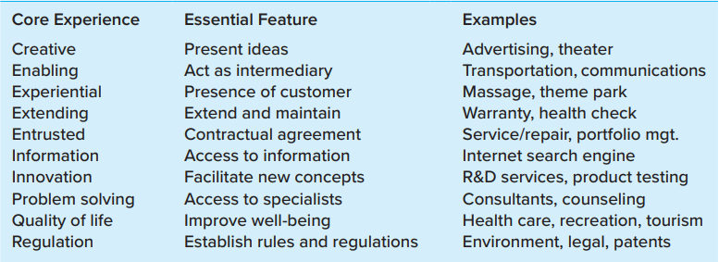
Service-Dominant Logic
Page 11 of text book

Slide 48
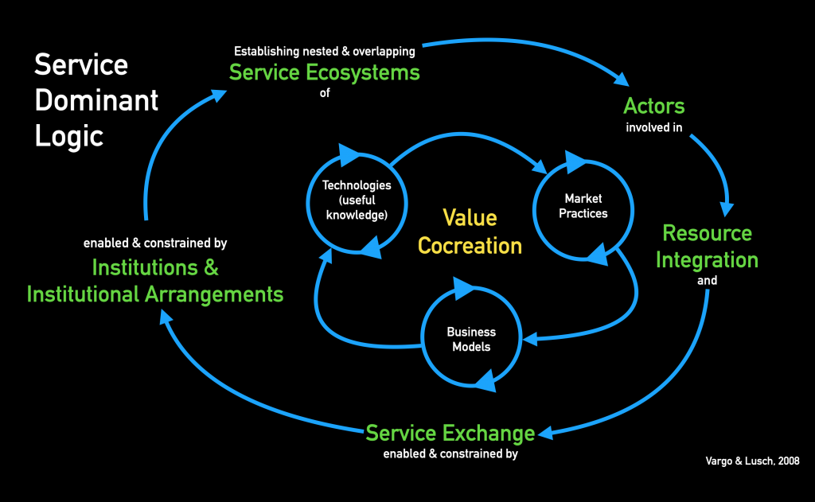
Service-Dominant Logic
https://intelligente-organisationen.de/service-dominant-logic

Slide 49
Elements of Service Delivery System
Explain briefly elements of Service Delivery System?
OR
Short notes on “Service Delivery System Elements”?

Slide 50
Elements of Service Delivery System
Service Culture
Employee Engagement
Service Quality
Customer Experiences
Taj Hotel, Reliance JIO, Airline Industry, Travel and Tourism, Consultancy Services etc.

Slide 51
Elements of Service Delivery System

Slide 52
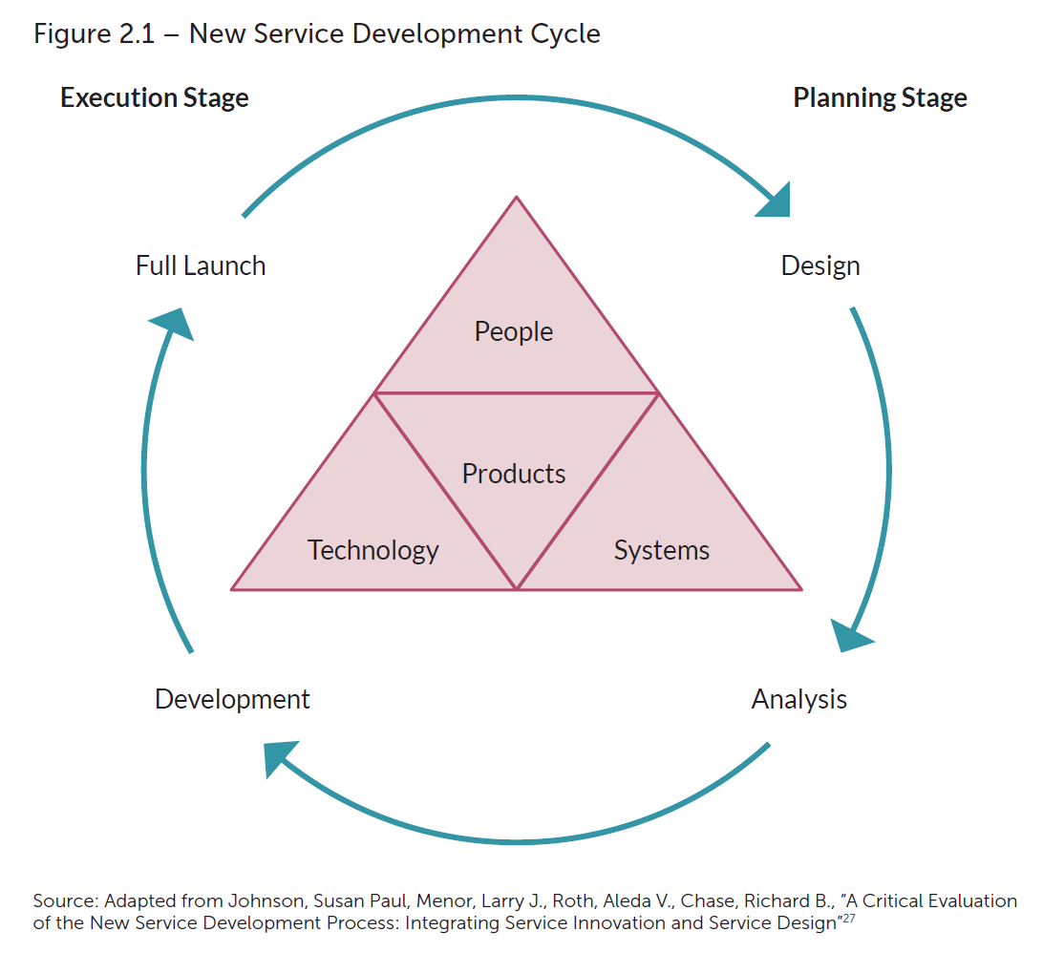
New Service Development Process Cycle

Slide 53
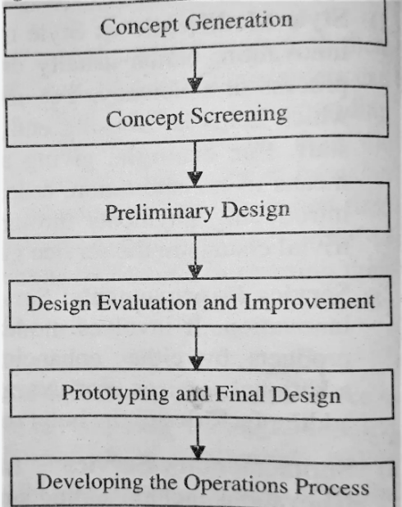
New Service Development Process Cycle

Slide 54
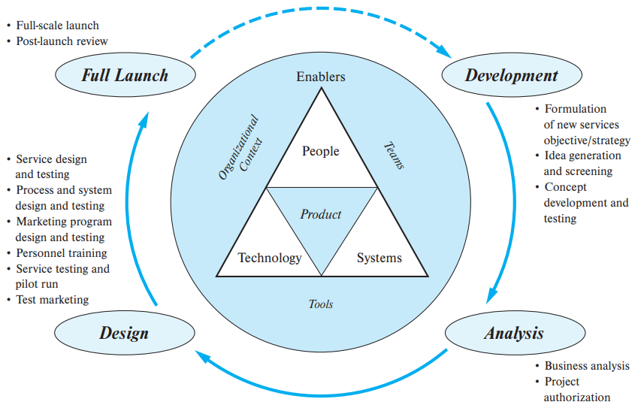
New Service Development Process Cycle

Slide 55
New Service Development Process Cycle
Existing Customers
New Customers
Existing Market Development
New Market (Customers)
Existing Services
New Market Development
Diversification
New Services
Ansoff Matrix

Slide 56
New Service Development Process Cycle

Slide 57
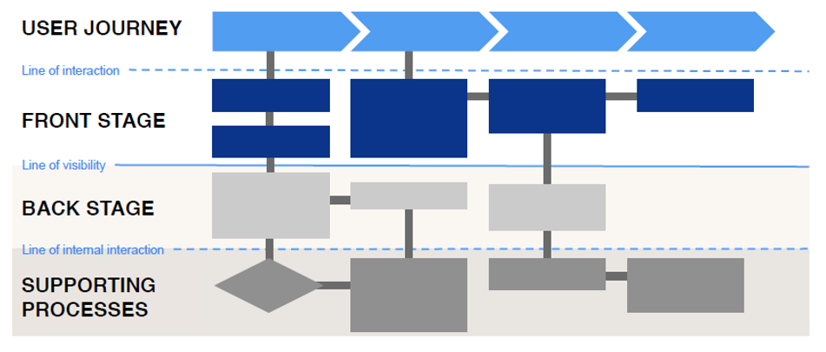
Service Blueprint

Slide 58
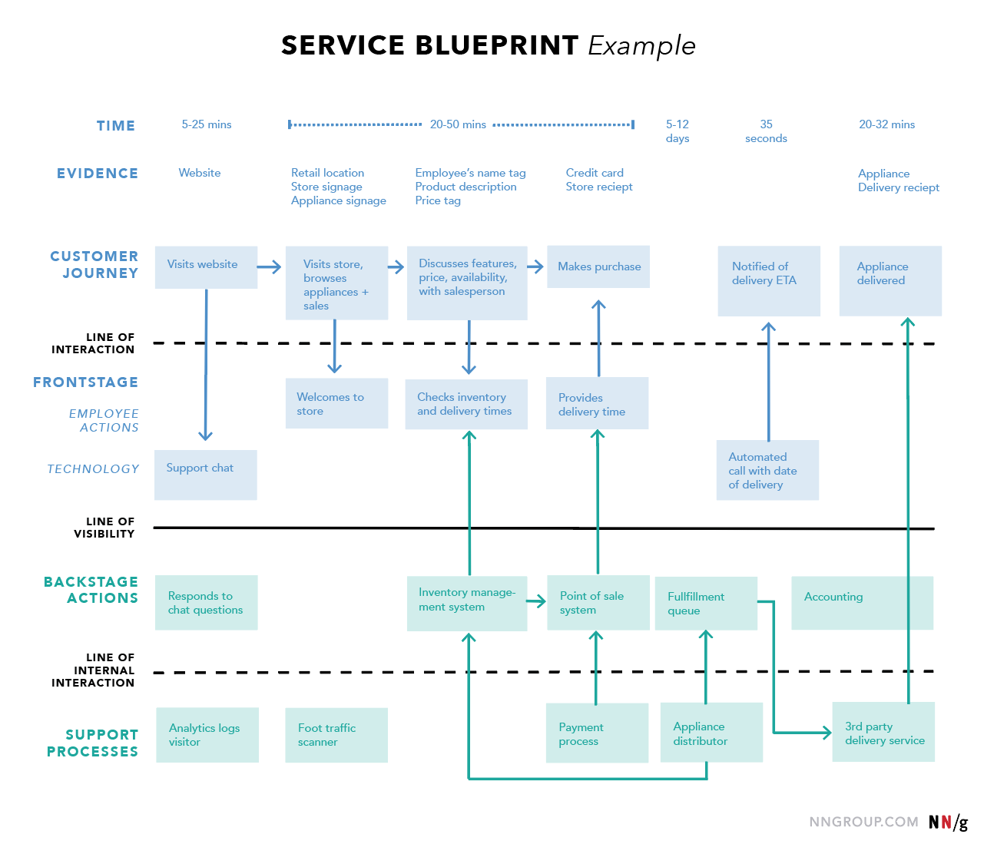
Service Blueprint

Slide 59
Practical
https://www.youtube.com/watch?v=DzVoqNG8VTo
10 - Planning the Service Delivery System

